Slide 1
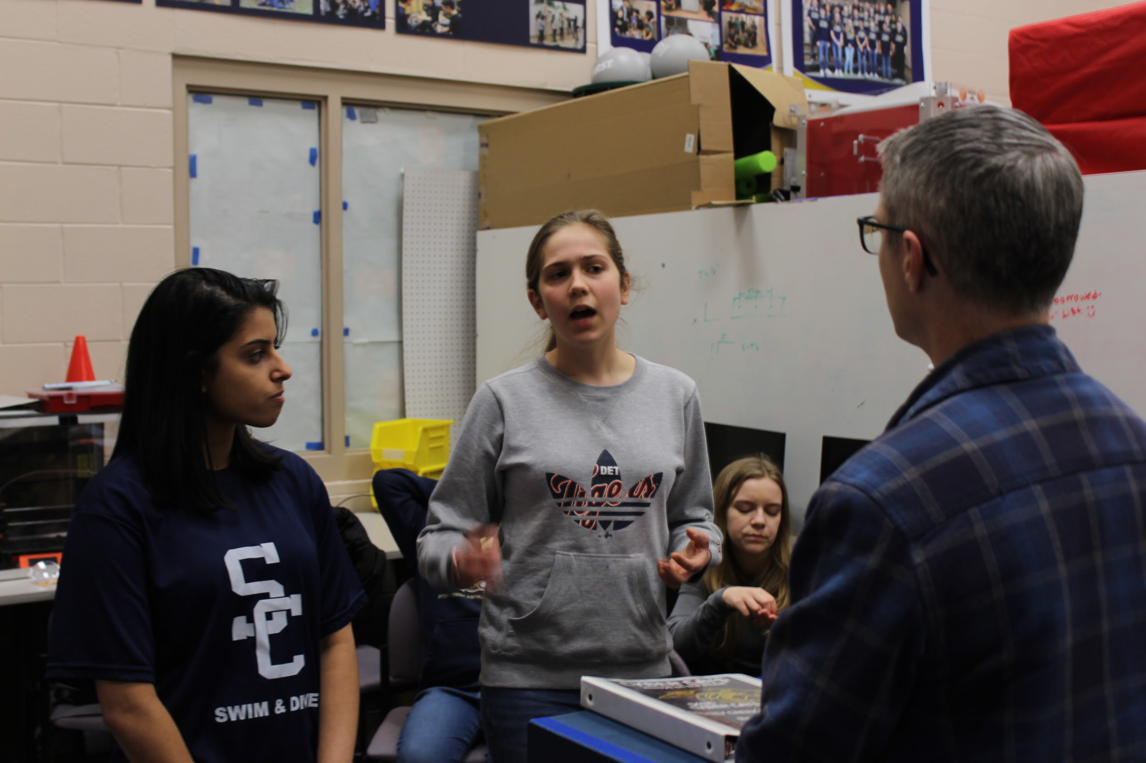
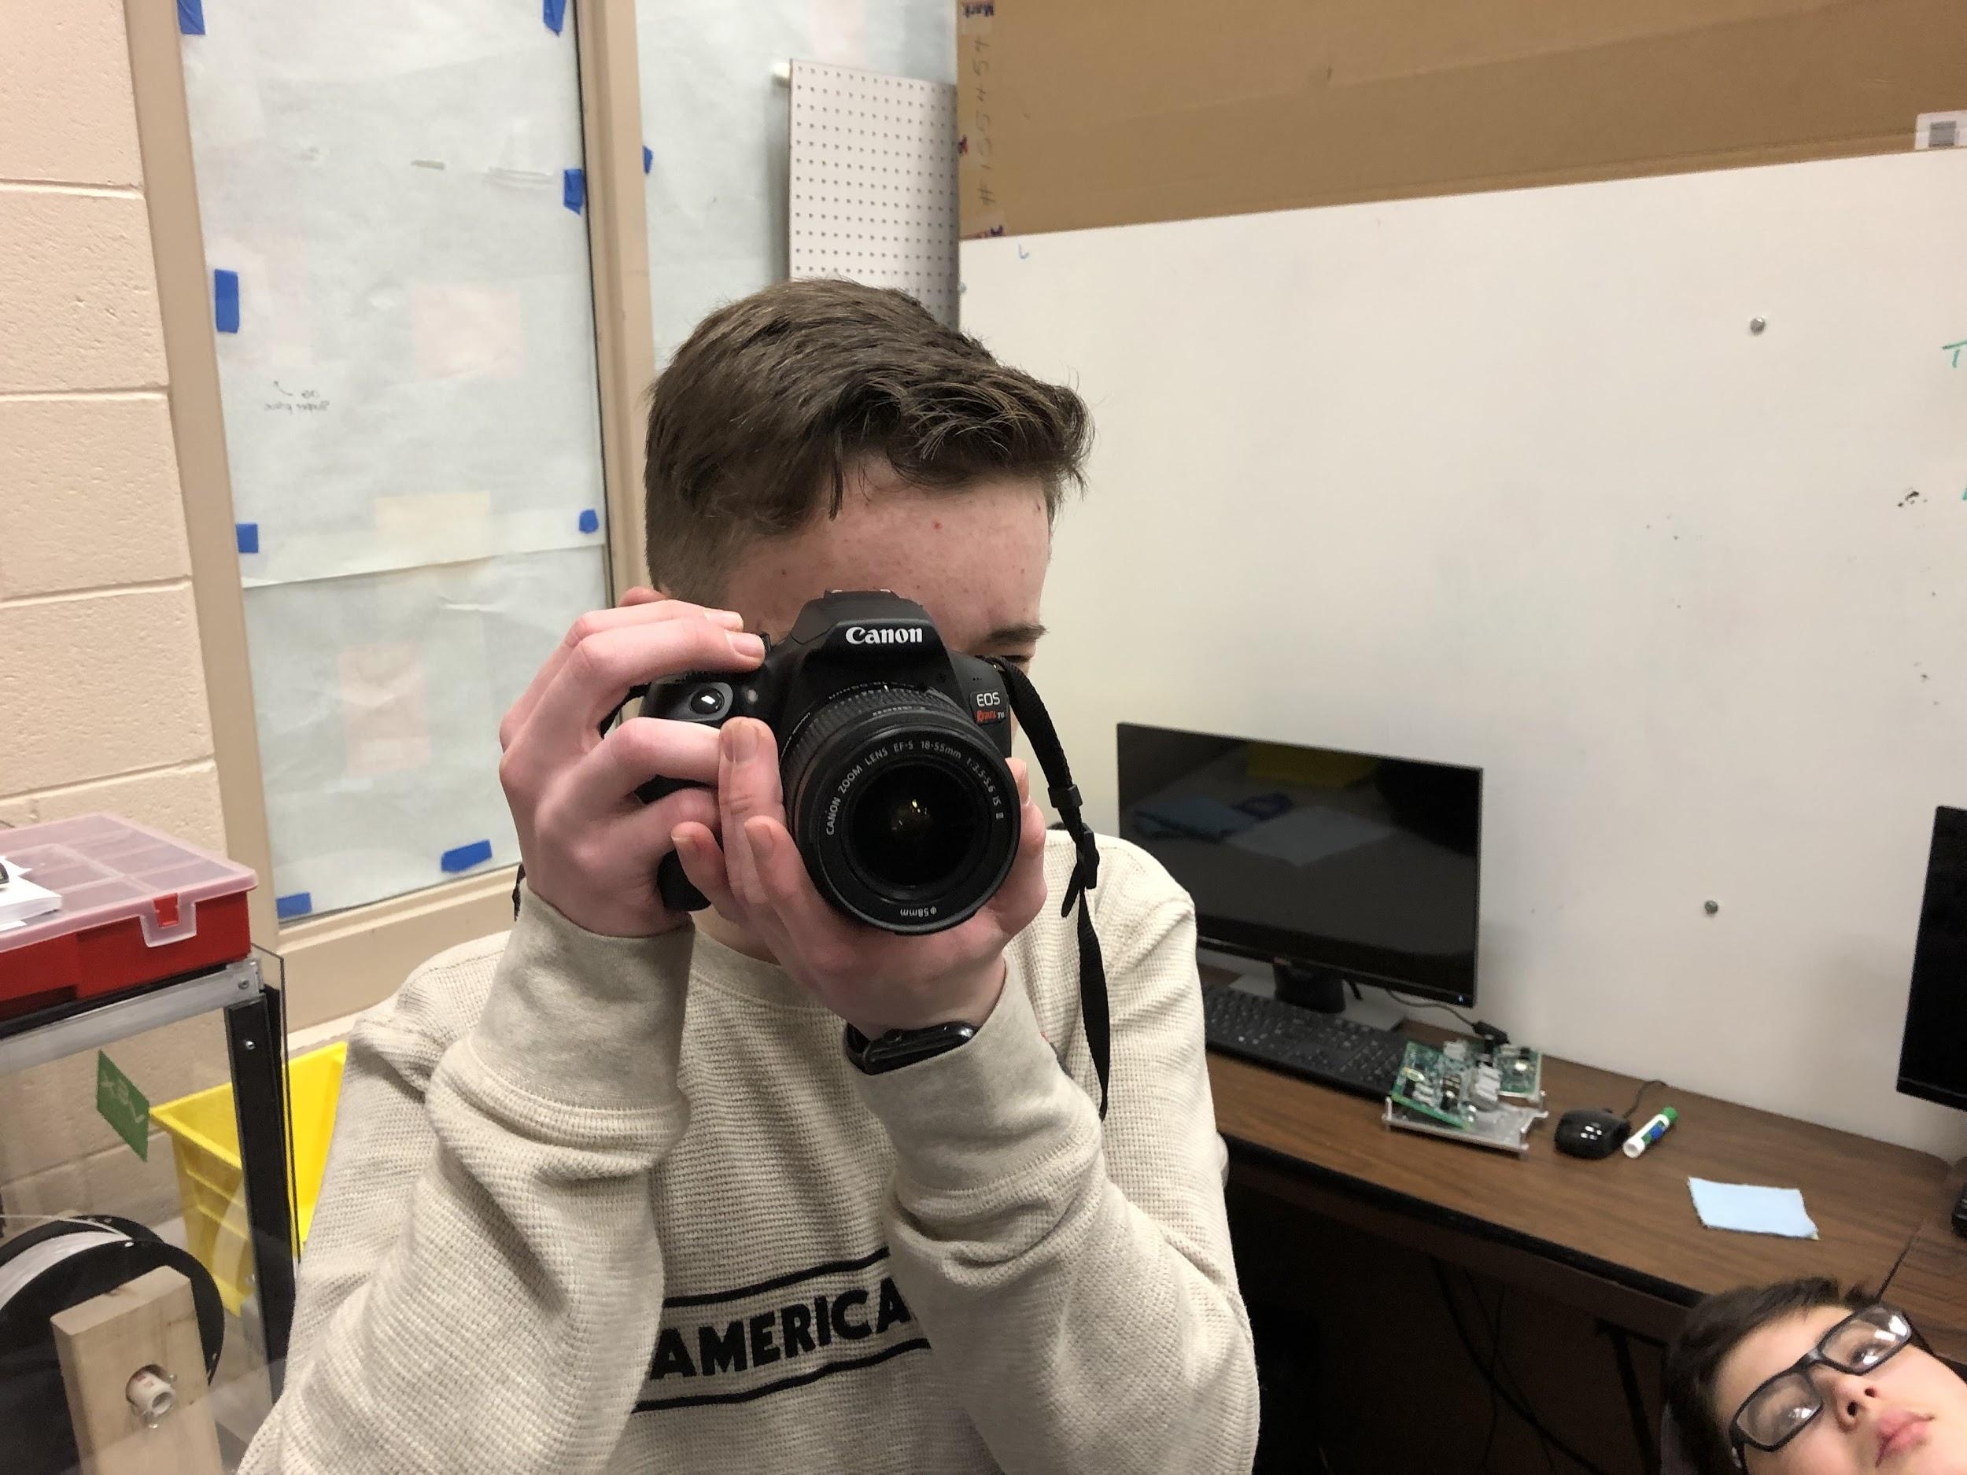
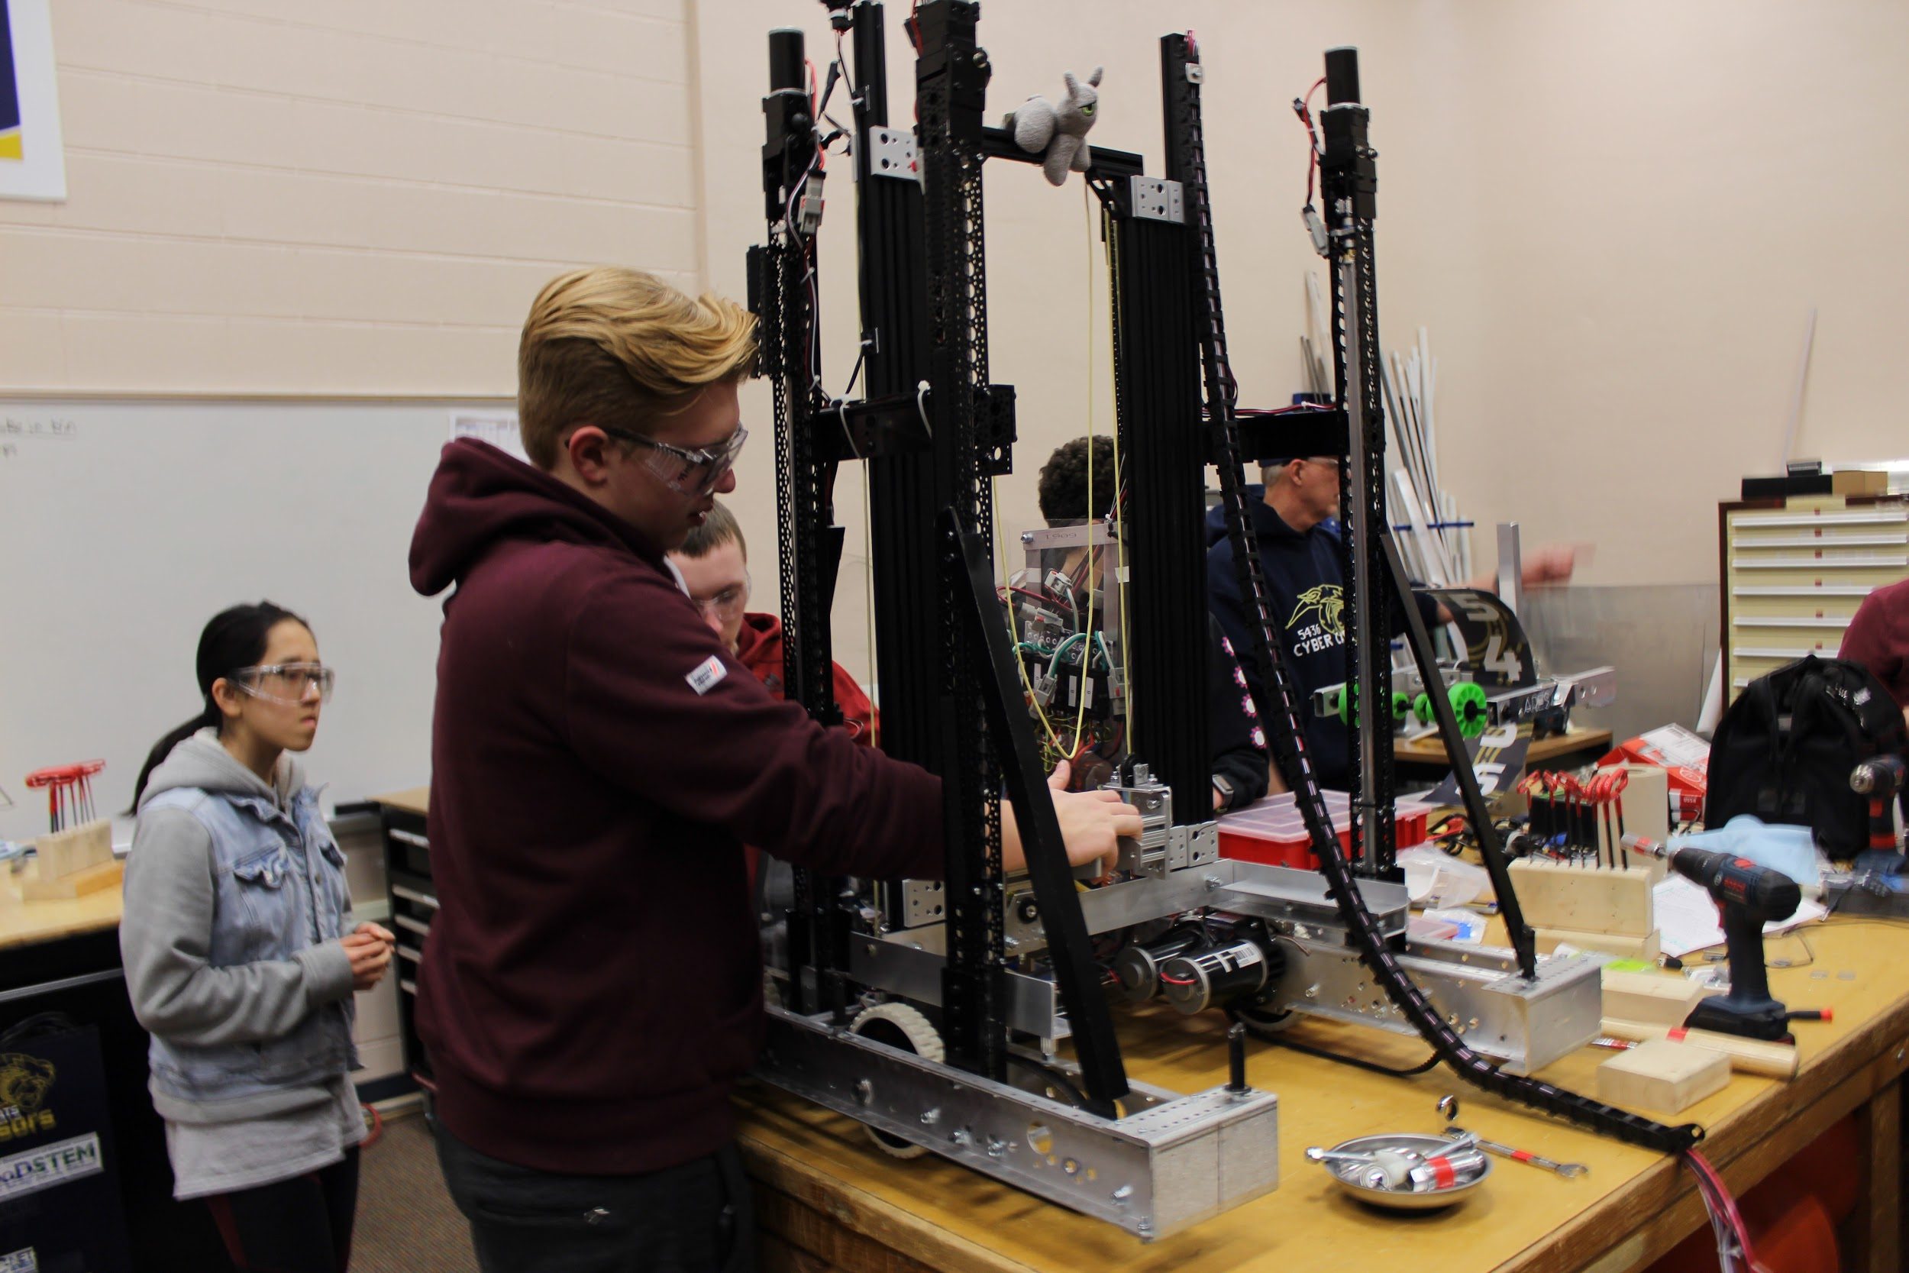
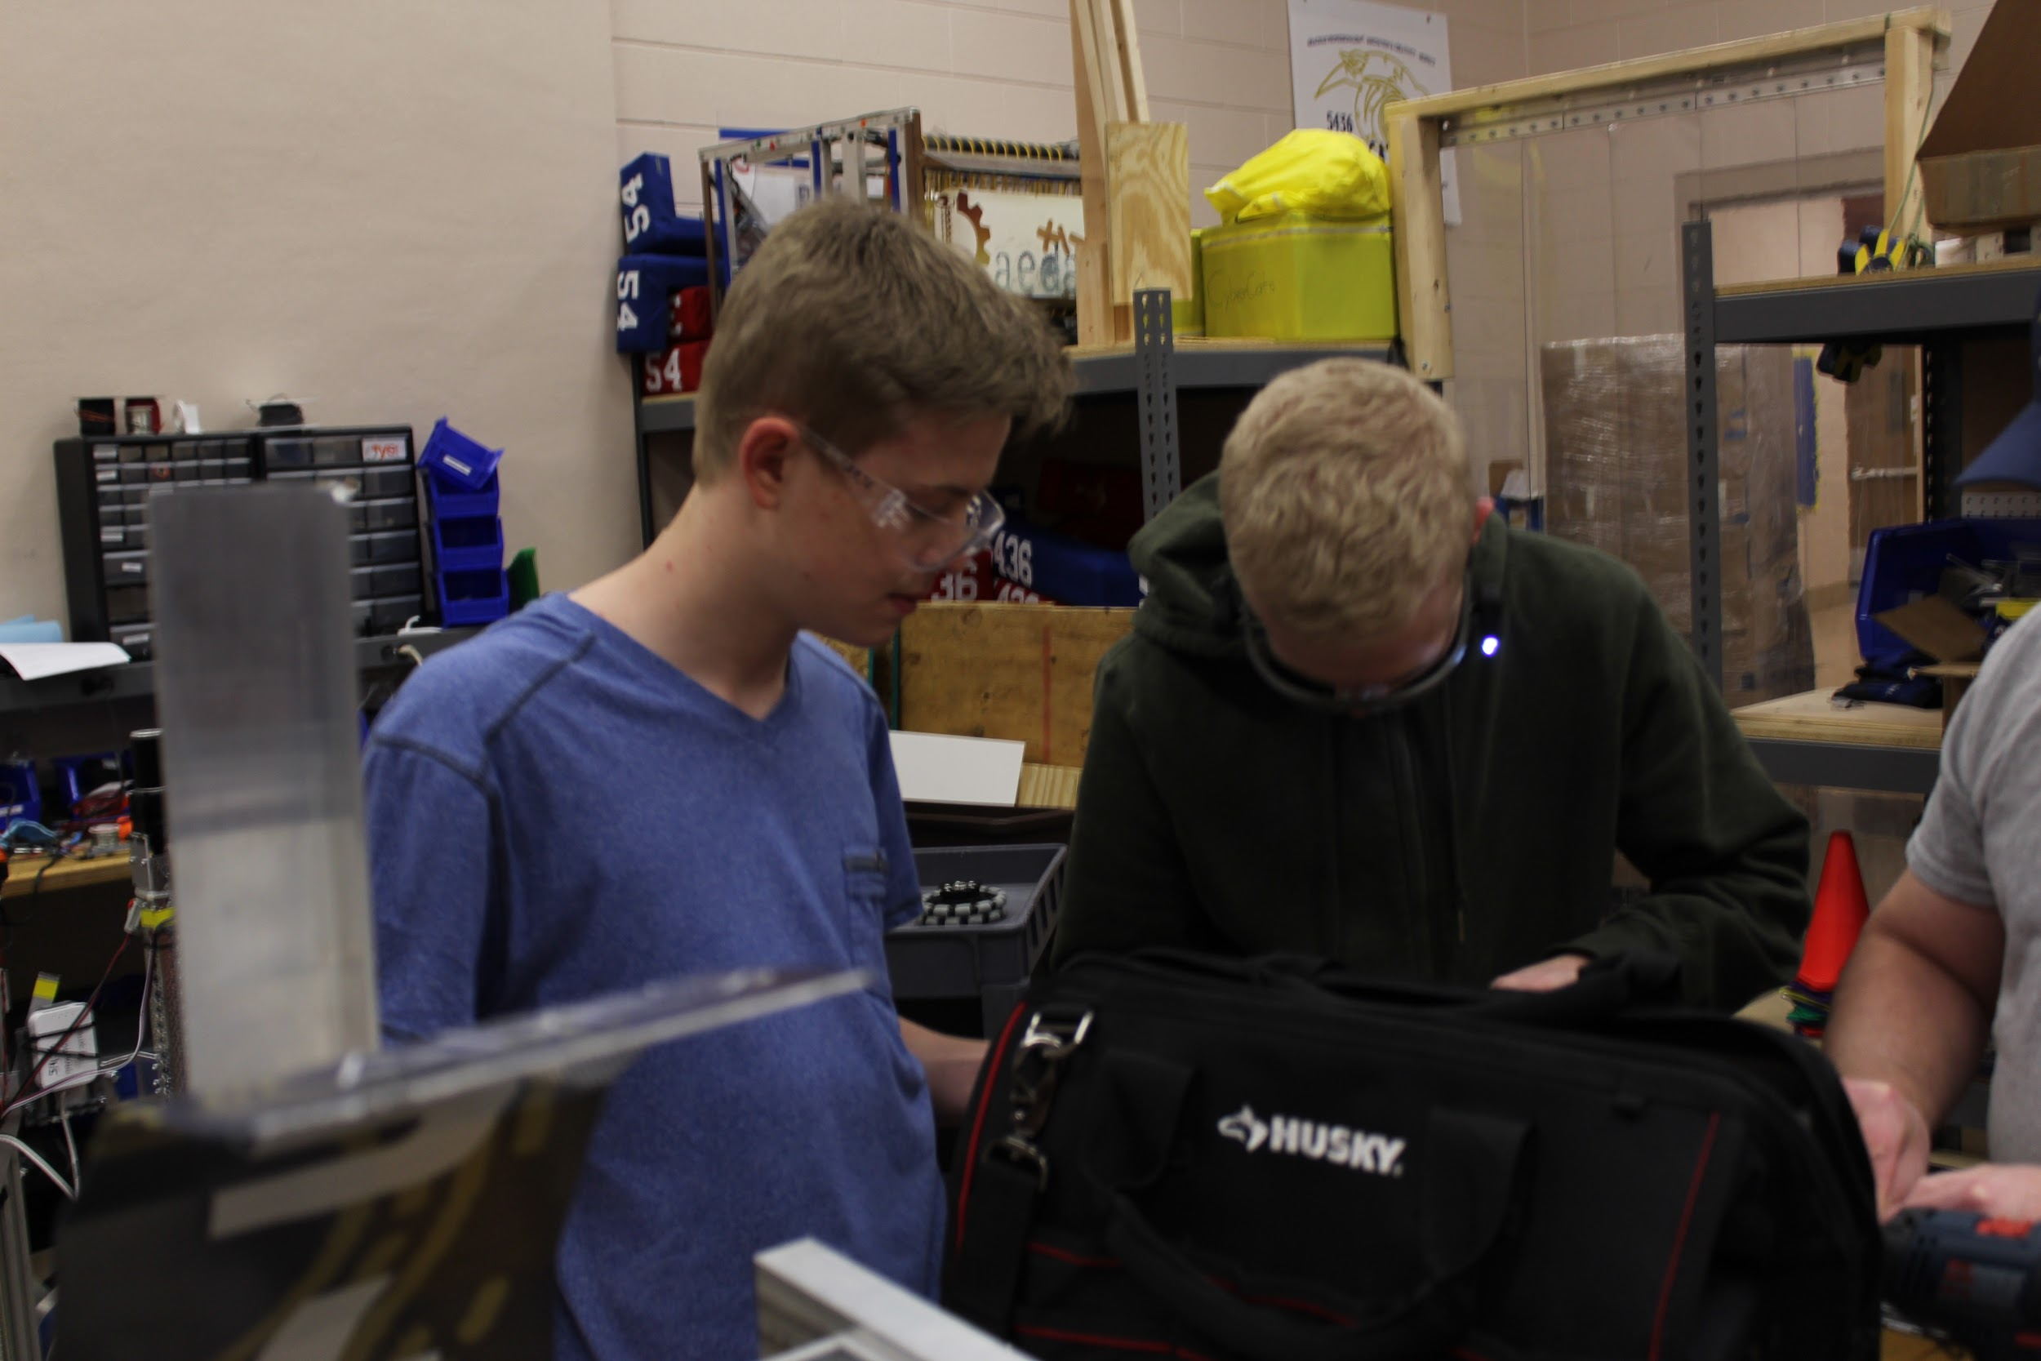
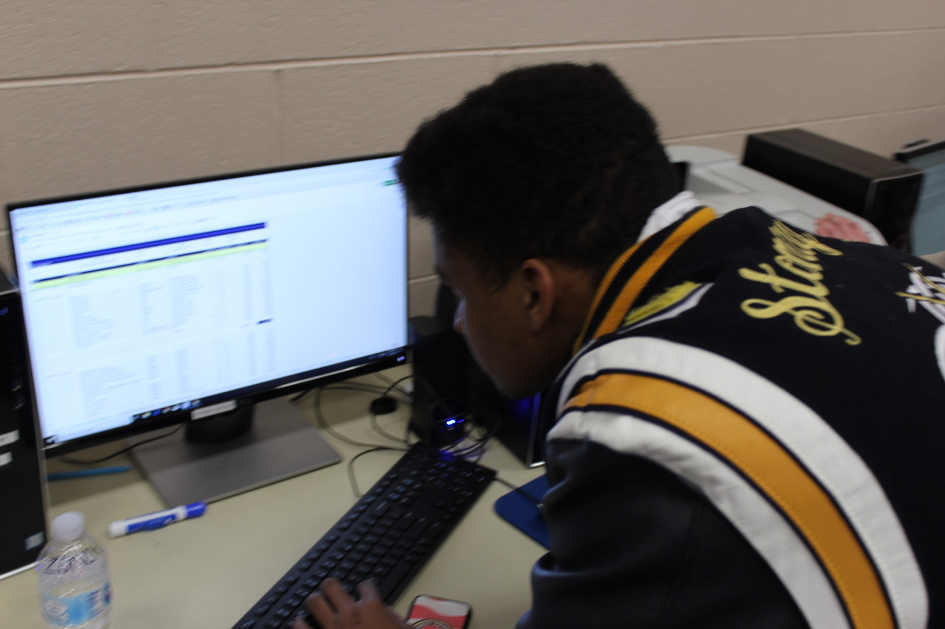
The Weekly Roar
2018-2019 Edition 7
Student Interview
Question: What’s your favourite part of robotics?
Zoish: I like giving presentations and attending competitions.
Weekly Focus
Photo/Video
They take quality photos of the team
They take footage for the chairman/s video
This week they have,
Continued to take and organize photos
Updated the website
Prepared cameras for competition
Robot Status
Reminders
Game: https://bit.ly/2nucN0z
Southfield District: 3/1-2
Meet the Cyber Cats: 3/9
Troy District: 3/29-30
Website: cybercats5436.com

