Slide 1
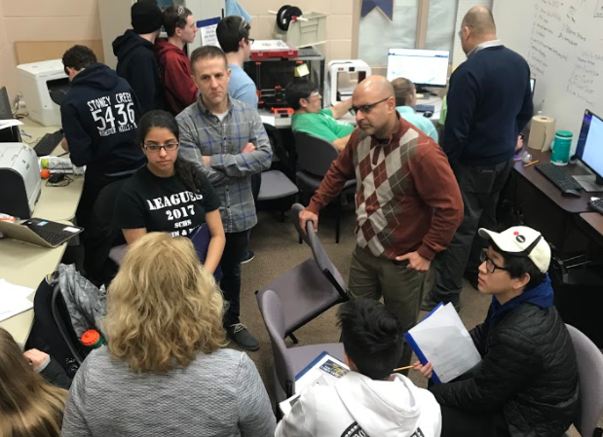
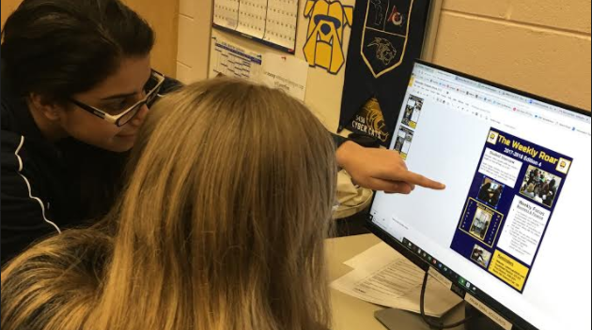
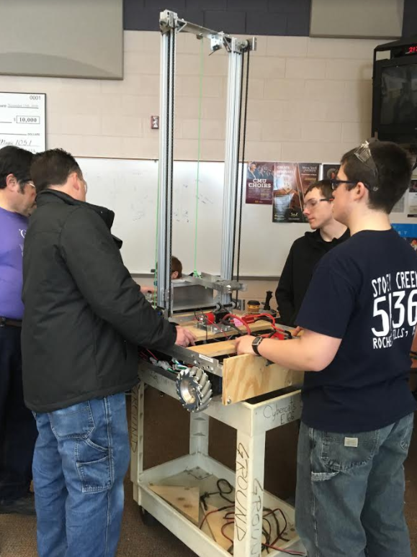
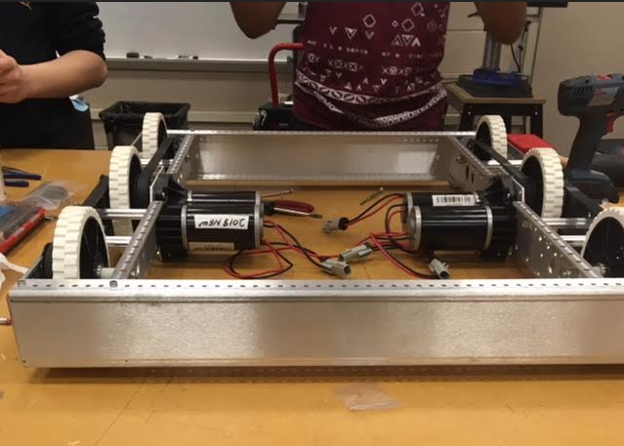
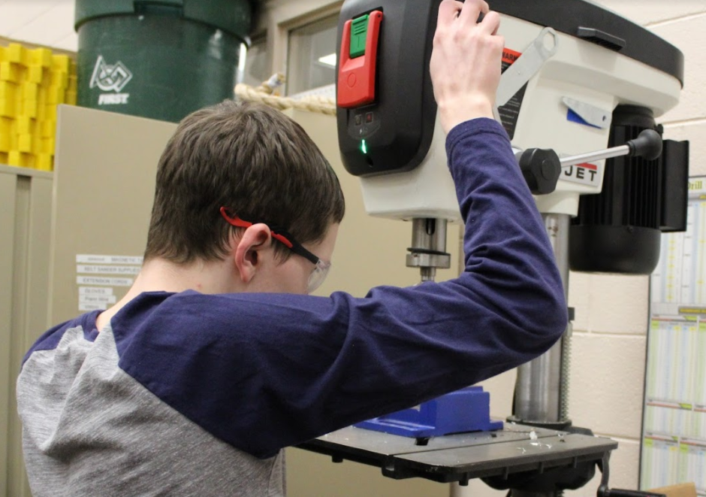
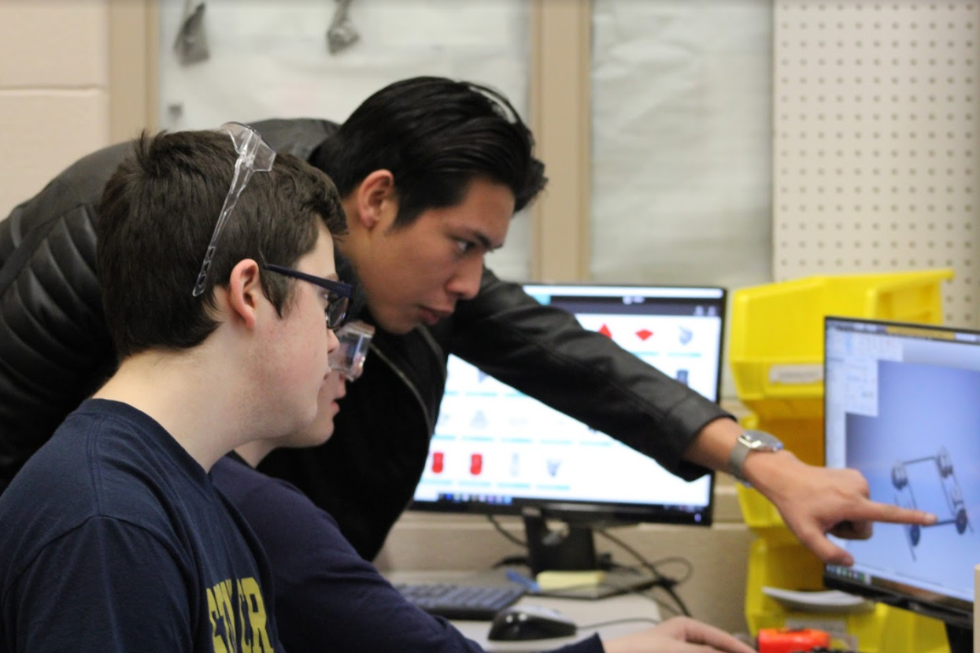
The Weekly Roar
2018-2019 Edition 2
Student Interview
Question: What valuable skills has robotics taught you that will help you in life?
Sarah Carlson: Robotics has taught me how to be an effective leader. I have also learned how to safely use some power tools.
Student interview
Weekly Focus
Business & Finance
The Business and Finance Team is responsible for writing the business plan, which is a documentation and plan of everything our team does
This year, they are also creating a Chairman’s award submission
This week, they have
Finished Updating Business Plan in preparation for submission
Finished the Chairman’s award submission
Robot Status
Reminders
Website: cybercats5436.com
Southfield District: 3/2-3/3
Troy District: 3/30-3/31
North Hill Science Fair: 2/8

